Slide 1
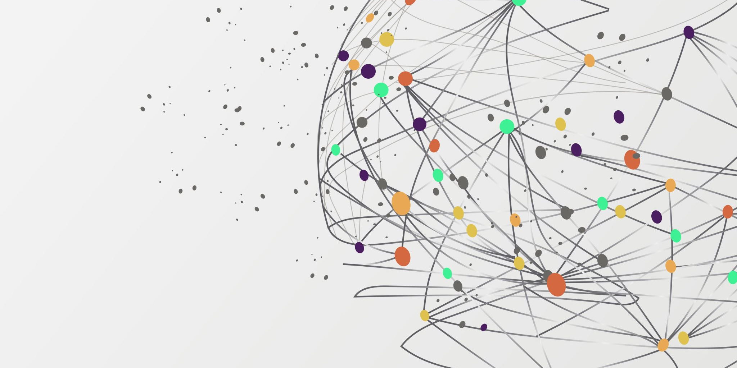

Personal Risk Assessment
By: Keegan Heaton

Slide 2
Executive Summary
A Personal Risk Assessment is a systematic process of finding potential hazards and risks associated with everyday tasks. It involves evaluating the likelihood and severity of damage that could happen due to identified hazards. In this assessment, I will cover vulnerabilities in my day-to-day life and list the dangers behind each vulnerability.

Slide 3

Topics of interest
Topics of interest include:
Vehicle security
Laptop Configuration
Mobile security
Privacy
Terms of Service

Slide 4
Vehicle Security – Current Hazards
My vehicle has vulnerabilities including; easy to bypass doors, accessible trunk, no car alarm. My car is a 2003 Ford Mustang, and the door windows can easily be bent back, allowing the thief to press the unlock button with a hanger or stick. The thief can also break the glass windows. The trunk is accessible by folding back the backseats, making any valuables hidden in the trunk easily accessible. There is also no car alarm for unknown reasons.

Slide 5
Vehicle Security – Mediation tactics
Nothing can be done about thieves breaking in the cab. The doors can easily be bypassed using force. However, the trunk can be fortified, and the car alarm can be fixed or replaced.

Slide 6
Trunk Fortification
To secure the trunk for valuables, building a wall between the cabs back seats and the trunk is an inexpensive solution. By building the wall between the cab and trunk, it is harder to immediately access the trunk from the cab as it is no longer connected to the cab. Additionally, the trunk doesn’t unlock the same way as the doors. The unlock switch for the trunk is hidden around the console on the passenger side, making it out of the way and hard to find.

Slide 7
Car Alarm Replacement
Although it takes 10 seconds for thieves to steal something from a vehicle, a car alarm is still useful for immediate detection. The most likely causes for a faulty car alarm are electrical faults and aftermarket alarm issues. An electrical fault would require the sensor, wiring, or control module be replaced to fix the car alarm. (RAC, 2023) If it’s an aftermarket issue, then another alarm system would need to replace the faulty system. (Worthless Whips, 2020, XXXX)

Slide 8

Laptop Configuration – Current Hazards
The current vulnerabilities for the laptop I’m using includes; unconfigured firewall, unconfigured OS settings, and unsecured networks

Slide 9
Laptop Configuration – Mediation Tactics
To secure the laptop I’m using, its important to configure the firewall, disable any unnecessary services, features, and protocols, restrict user privileges, and enable logging and monitoring

Slide 10

Firewall Configuration
Proper firewall configuration is vital to the security of any desktop or laptop. To secure my laptop, I’ll restrict network ports, protocols and services that are explicitly needed. I will also configure the firewall rules to deny all, permit by exception. WAFs, or Web Application Firewalls, are also important as WAF firewalls can monitor and block communication up to the application layer of the OSI model. (F5, 2023)

Slide 11
Unnecessary Services
Unnecessary services, features, and protocols are tools like SMBv1.
SMBv1, also known as Server Message Block, is a Microsoft communication protocol used for file sharing and printer services. Its not a useful protocol on personal computers or gaming computers and leaves vulnerabilities for threat actors to use.
For services, settings services like Bluetooth support , diagnostic tracking, internet Connection Sharing, and remote registry should be disabled or set to manual. (AnandK@TWC, 2022)
Bluetooth Support can be a vulnerability for Bluetooth attacks, and if you're not using Bluetooth devices there is no reason to keep it enabled.
Diagnostic tracking stops the sharing of telemetry and data.
Internet connection sharing is a old service that allows the computer to share internet connection to other devices. CVE-2023-38148 is a Remote Code Execution vulnerability connected to the ICS service. (Ojha, 2023)
Remote Registry allows for someone with the correct credentials to access the registry remotely. This is best disabled as it’s a massive vulnerability. For example, CVE-2023-36401 is a vulnerability that allows privileged users to remotely executed arbitrary code on a target system. This happens because of an integer overflow in the remote registry service. (Cybersecurityhelp, 2023)

Slide 12
Restrict User Privileges
To keep a device from being changed by anyone other than the owner, restricting user privileges is a must. The key is to make one administrator account with all privileges and any other accounts are users without admin rights. This will make it harder for malicious actors to escalate their rights. Additionally, a strong admin password will stop anyone without permission from changing the device settings or installing malicious software. (B.Sc. Geeks, 2019)

Slide 13
Monitoring and Logging
Monitoring and analysis tools can detect any unusual activity, such as unauthorized connections, suspicious data, or malware. Network mapping tools like Nmap can help monitor network traffic. Microsoft firewall and task manager logs can help with any suspicious log in attempts, background processes, or hardware allocation. The key is to routinely check logs to make sure all processes are genuine.

Slide 14

Mobile Security – Current Hazards
Current hazards for my phone include phishing, smishing, and vishing attacks. Phishing attacks are social engineering scams where an individuals tries to entice sensitive information. Smishing is another type of cyberattack that uses text messages to trick individuals into spilling sensitive information or clicking on malicious links. Vishing is a type of cyberattack using phone calls and pressuring callers into giving away sensitive information.

Slide 15
Phishing Attacks
To detect phishing attempts, applications like TotalAV Mobile Security are great tools. TotalAV WebShield effectively blocks any malicious links from redirecting the user to malicious sites or downloading a malicious payload. As a paid subscription, the price is only 2.50$ a month. Additionally, its also good practice to not open any links from suspicious sources(TOTAL WebShield, 2024)

Slide 16
Smishing Attacks
To protect against smishing attacks, its important to enable spam protection and activate caller ID. Activating these settings will block potential smishing attacks and filter out spam messages.
Trend Micros also has a subscription service that will filter messages, block suspicious links and attachments in messages. Trend Micro Mobile Security works similarly to TotalAV, but extends the protection from just Phishing to Smishing as well. (Checkpoint, 2024)

Slide 17
Vishing Attacks
The key to not falling for vishing attacks is to not divulge any sensitive information over the phone. This includes login information, credit card numbers, or personal identification. Additionally, I can hang up and call the company they represented to verify the caller’s identity. For any unknown calls, I will start letting the caller go to voicemail. If its important, they will send a voicemail afterword.

Slide 18
Privacy – Current Hazards
Privacy hazards include; Spying and snooping, transparency, and identity theft. Spying, snooping, and a alack of transparency are done by advertisers to make a detailed profile about individual preferences. Furthermore, Identity theft can stem from a multitude of things, from sensitive social media posts to social engineering scams.

Slide 19
Privacy – Mediation Tactics
Mediation tactics include using Privacy-focused search engines and using only HTTPS websites.

Slide 20
Privacy-focused Search Engine
Privacy-focused search engines like brave are transparent in their collection and storage of data. Brave also gives the following features:
Brave doesn’t log user activity and has a no-ad policy.
Brave provides privacy features like ad-blocking, anti-fingerprinting, and the ability to connect to the Tor network.
Using Brave instead of Google Chrome will reduce the flow of data collection about my preferences and allow me to have more control over what information is collected. (Sarwar, 2021)

Slide 21
HTTPS Websites
HTTPS encrypts the communication between the browser and the website, protecting data from being intercepted and tampered with by malicious actors.
HTTPS also verifies the credibility and safety of a site.
The key to identifying HTTPS is finding the padlock icon on the search bar or going to the “tune” icon, the icon google substituted for the padlock, to find whether the site is secure or not.

Slide 22
Terms of Service –Current Hazards
Social Media platforms like TikTok and Instagram have invasive terms of service agreements. This includes TikToks invasive tracking measures against users and Instagrams ability to monetize user content without explicit consent. This means TikTok and Instagram can sell sensitive information like location and login information.

Slide 23
Terms of Service – Mediation Tactics
Mediation tactics include deleting the software or minimizing the permissions of the software.

Slide 24
Deleting Software
Deleting TikTok stops it from collecting any sensitive information. I deleted TikTok the second I found out that TikTok monitors all keyboard inputs and taps made by the user. This information it collects through the keyboard can include passwords, credit card information and other sensitive information. (Lomas, 2022)

Slide 25
Minimizing software permissions
Minimizing software permissions on social media platforms like Instagram can reduce the amount of data it can collect. I disabled permissions to camera, microphone, contacts, photos, and location. I also don’t post anything to my social media account to keep my location off the platform. This effectively stops any information from being collected by Instagram. However, its best to delete Instagram to effectively stop any data collection. (The Guardian, 2012)

Slide 26
Overview
To improve my physical, online, and legal security, I selected points of interest I’ve yet to change in my life. Then, I researched mediation tactics to reduce the severity of the vulnerability. Across all five topics of interest, there were a total of 13 vulnerabilities I eliminated in my day-to-day life.

Slide 27
References
AnandK@TWC. (2022, March 3). Which Windows Services can you safely disable in Windows 11/10? The Windows Club. https://www.thewindowsclub.com/which-windows-10-services-safe-to-disable
Atomicorp. (2023, September 21). Atomic OSSEC On-demand Demo. Atomicorp -- Unified Security Built on OSSEC. https://atomicorp.com/atomic-ossec-ondemand-demo-thanks/#ao-trial
B.Sc. Geeks. (2019, September 9). B.Sc. GEEKS - Security in computing. Google Sites: Sign-in. https://sites.google.com/view/bscgeeks/security-in-computing
Checkpoint. (2024, January 24). What is Smishing. CheckPoint. https://www.checkpoint.com/cyber-hub/threat-prevention/what-is-phishing/what-is-smishing/
Cybersecurityhelp. (2023, April 22). Multiple vulnerabilities in Microsoft Remote Registry Service. Vulnerability Intelligence by CyberSecurity Help s.r.o. https://www.cybersecurity-help.cz/vdb/SB2023111431
F5. (2023, May 26). What is a Web Application Firewall (WAF)? F5, Inc. https://www.f5.com/glossary/web-application-firewall-waf
GIAC Certifications. (2023, December 4). Global Information Assurance Certification Paper. https://www.giac.org/paper/gsec/35355/case-study-critical-controls-prevented-target-breach/140127
J, T. (2024, March 20). HTTP vs HTTPS: Key Differences and Which One to Choose for Your Site. Hostinger Tutorials. https://www.hostinger.com/tutorials/http-vs-https

Slide 28
References
Lomas, N. (2022, August 19). TikTok's in-app browser could be keylogging, warns analysis. TechCrunch. https://techcrunch.com/2022/08/19/tiktok-fb-in-app-browser-tracking-analysis/?guccounter=1
Microsoft. (2013, February 3). Redirecting. Redirecting. https://answers.microsoft.com/en-us/windows/forum/all/is-the-netlogon-service-necessary/b4dd8a83-99c7-4e16-8535-2c13022182a0
New Zealand Government. (2024, March 14). Disabling unnecessary services and protocols | CERT NZ. CERT NZ. https://www.cert.govt.nz/it-specialists/guides/unused-services-and-protocols/disabling-unnecessary-services-and-protocols/
Ojha, D. (2023, September 12). Microsoft and Adobe Patch Tuesday, September 2023 Security Update Review | Qualys Security Blog. Qualys Security Blog. https://blog.qualys.com/vulnerabilities-threat-research/2023/09/12/microsoft-patch-tuesday-september-2023-security-update-review
Osborne, C. (2023, October 18). 9 top mobile security threats and how you can avoid them. ZDNET. https://www.zdnet.com/article/9-top-mobile-security-threats-and-how-you-can-avoid-them/
PCmag. (2024, April 17). The Best Android Antivirus for 2024. https://www.pcmag.com/picks/the-best-android-antivirus-apps
RAC. (2023, May 3). What to do if your car alarm keeps going off | RAC Drive. RAC Breakdown Cover & Car Insurance | Route Planner | RAC. https://www.rac.co.uk/drive/advice/driving-advice/what-to-do-if-your-car-alarm-keeps-going-off/

Slide 29
References
Sarwar, N. (2021, June 26). Brave's secure search engine: is it a better option than google search? Screen Rant. https://screenrant.com/braves-secure-search-engine-google-search-privacy-alternative-benefits/
Shaw, H. (2024, March 27). 10 Best (REALLY FREE) Android Antivirus Apps for 2024. SafetyDetectives. https://www.safetydetectives.com/blog/best-really-free-antivirus-programs-for-android/
TOTAL WebShield. (2024, January 3). Pricing - Total WebShield. Home - Total WebShield. https://www.totalwebshield.com/pricing
Weatherbed, J. (2023, May 3). Google is retiring the lock icon in Chrome. The Verge. https://www.theverge.com/2023/5/3/23709498/google-chrome-lock-icon-web-browser-https-security-update-redesign
Worthless Whips. (2020, June 23). Aftermarket Alarm Leaves Me STRANDED! - Let's Get Rid of it [Video]. YouTube. https://www.youtube.com/watch?v=GgkiqtF9hls
Instagram reassures users over terms of service after massive outcry. (2012, December 18). The Guardian. https://www.theguardian.com/technology/2012/dec/18/instagram-issues-statement-terms-of-service

